Slide 1
Parallax Tolerant Image Stitching
Team_511
Bhavya kalra
Shrutimoy Das

Slide 2
Introduction
Image stitching or photo stitching is the process of combining multiple photographic images with overlapping fields of view to produce a segmented panorama or high-resolution image.
Parallax handling is a challenging task for image stitching.
We present a local stitching method to handle parallax based on the observation that input images do not need to be perfectly aligned over the whole overlapping region for stitching. .
We then develop an efficient randomized algorithm to search for a homography, which, allows for optimal stitching.

Slide 3
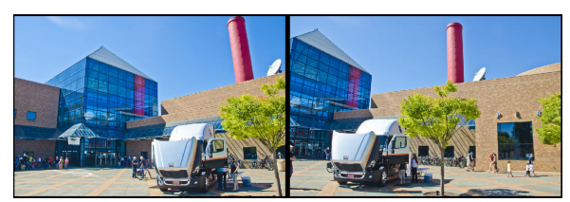
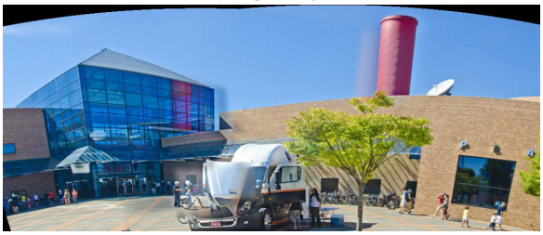
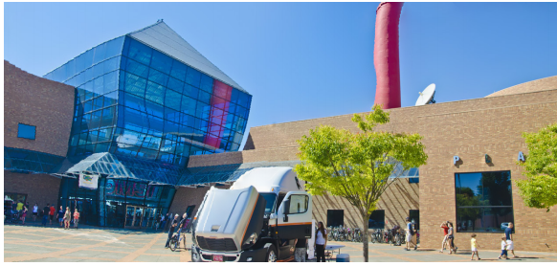
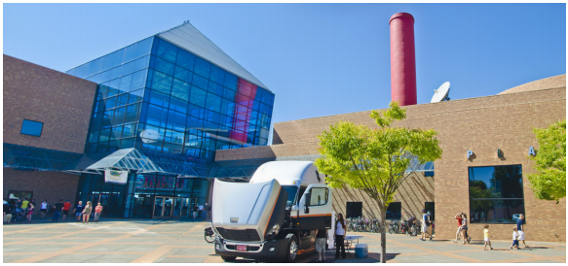
Problems with existing models
Input Images with parallax
Auto-stitch produces ghosting effect
Visual distortion using spatially-varying warping
Expected Result

Slide 4
Tasks to be performed
Detect Sift features for input images and edge maps of those images.
Alignment Quality Assessment
1. Graph cut seam finding Method
2. Homography Screening
Image stitching and blending

Slide 5
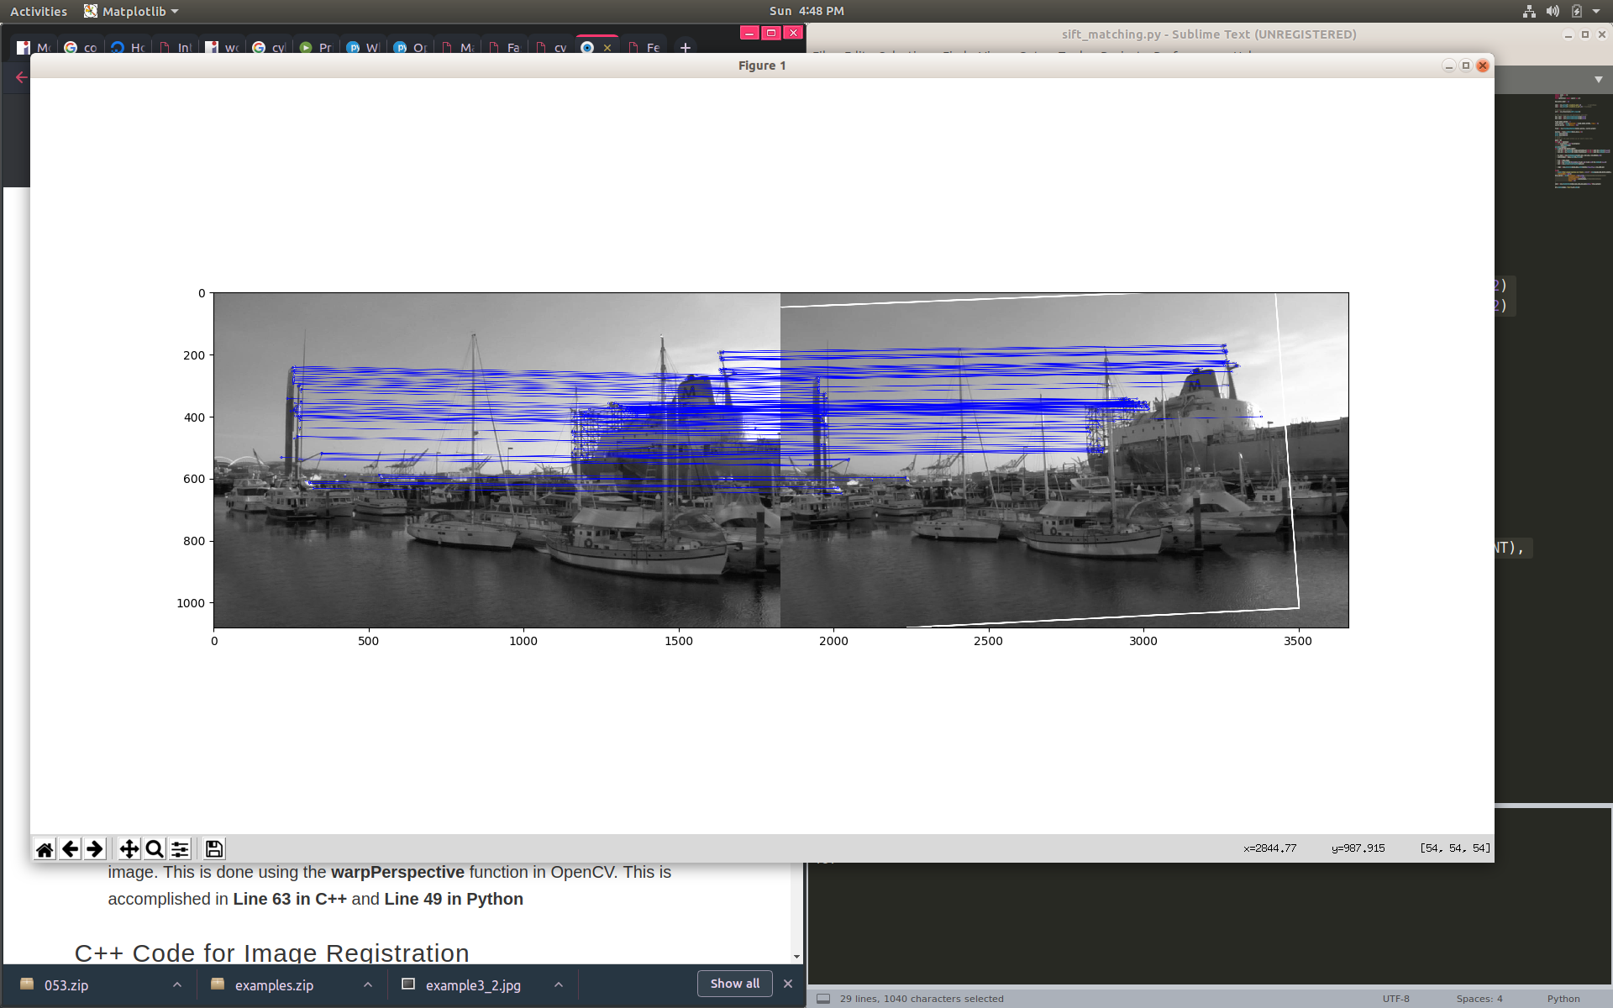
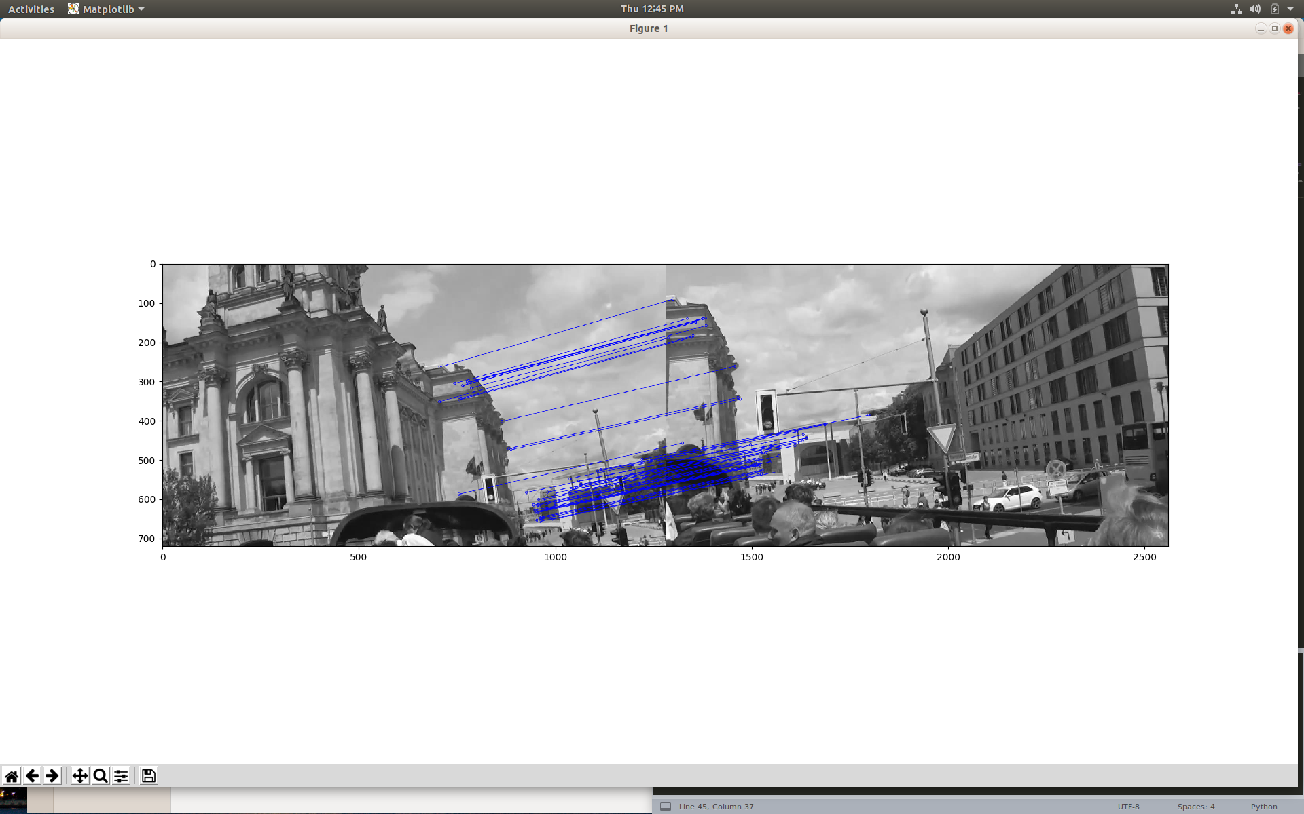
Sift on input images

Slide 6
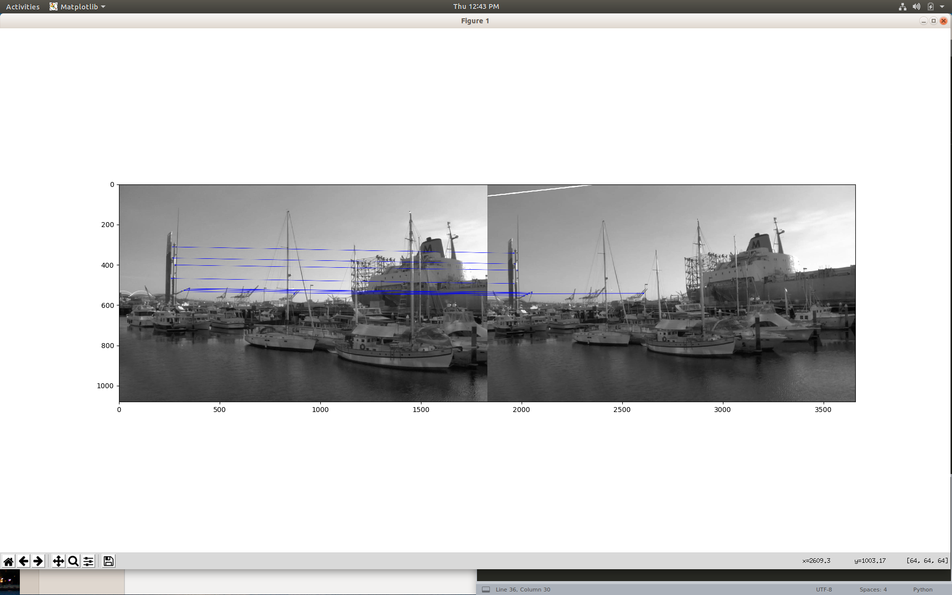
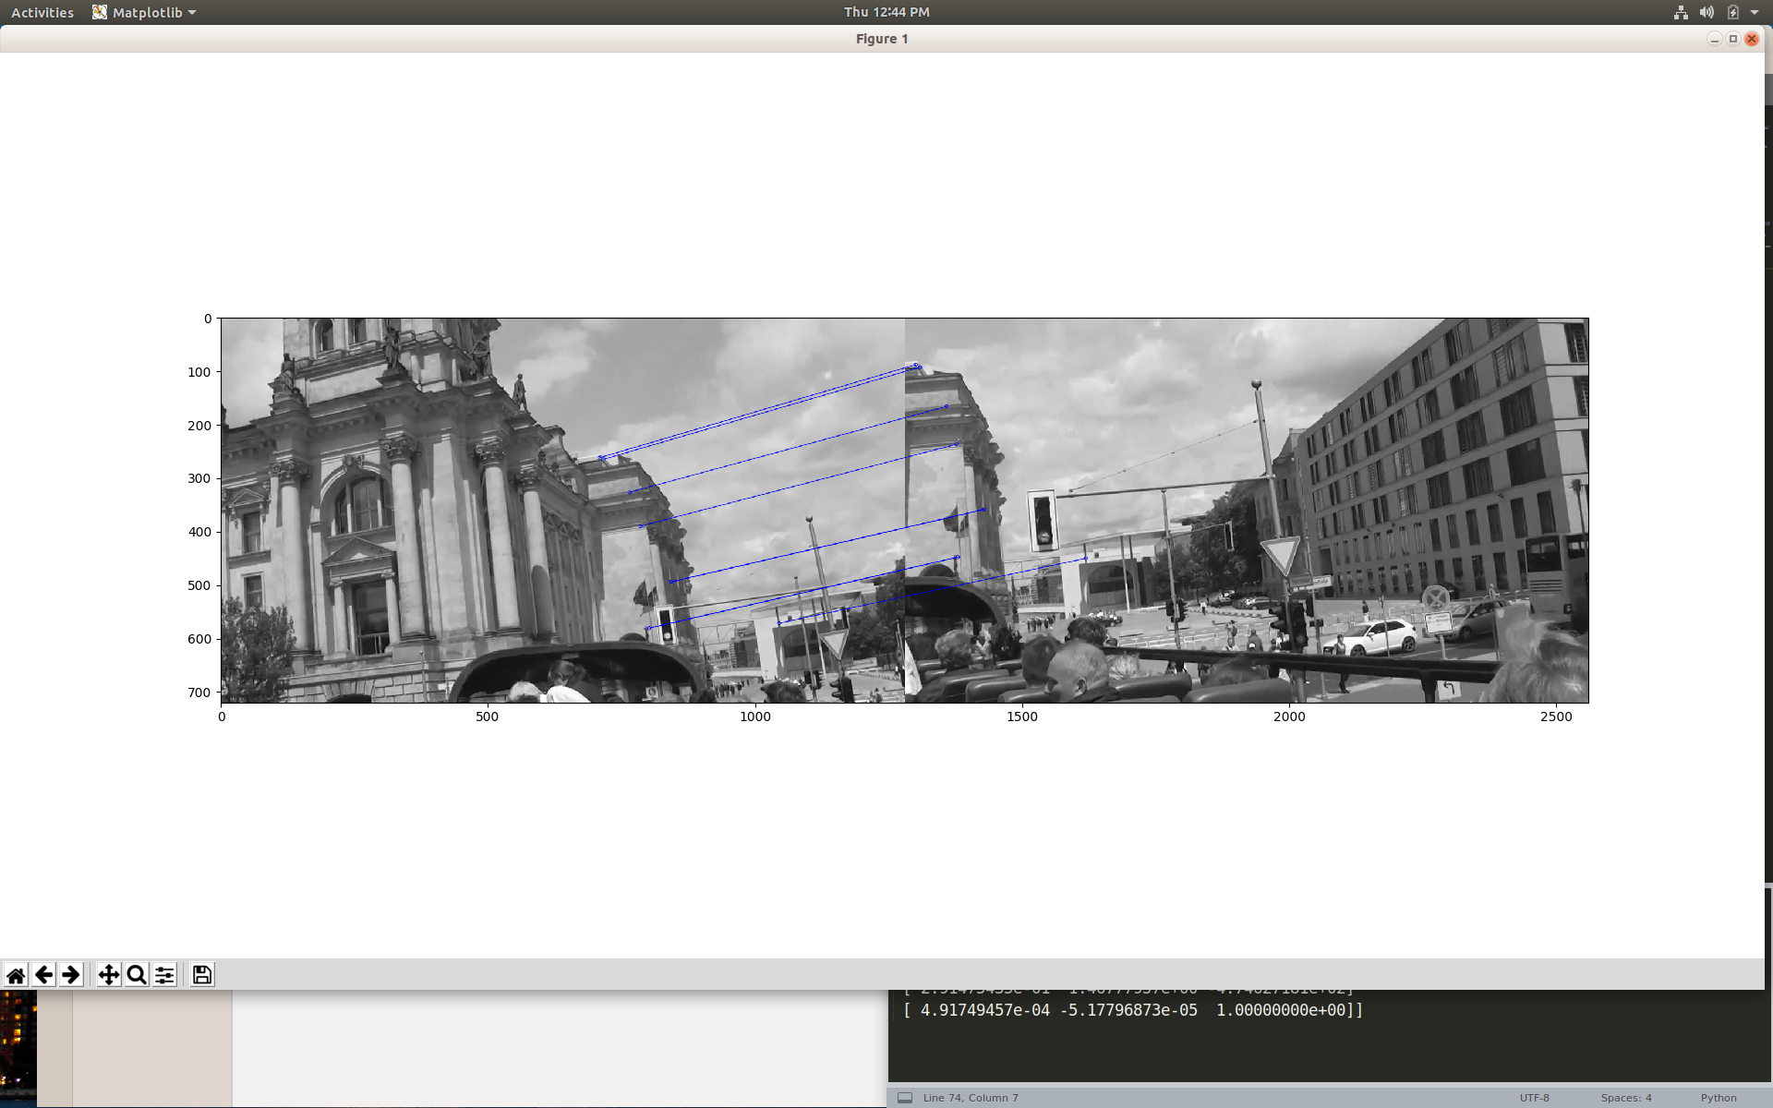
Sift on Edge Maps

Slide 7
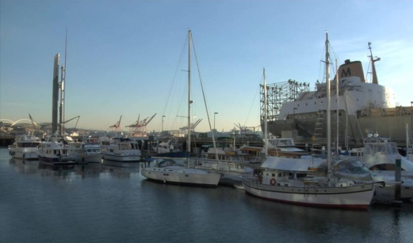
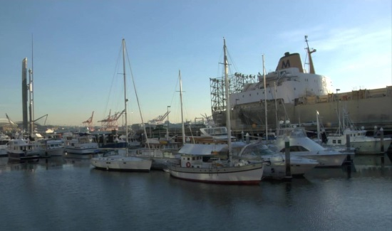
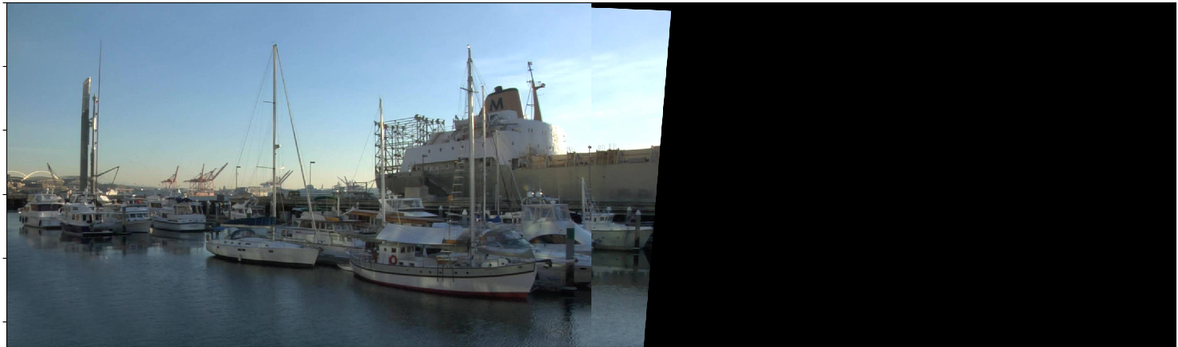
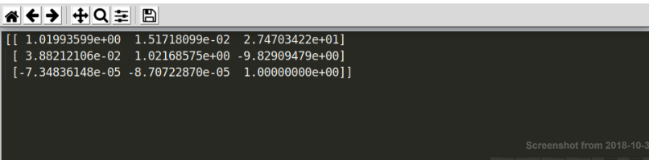
Results from using RANSAC for homography

Slide 8
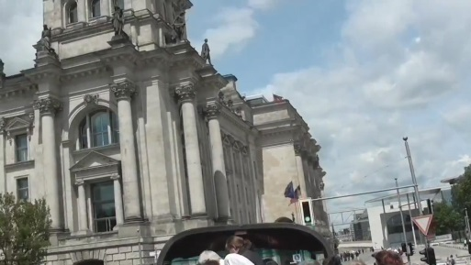
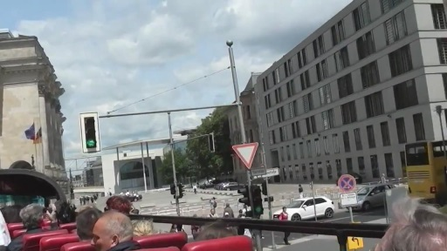
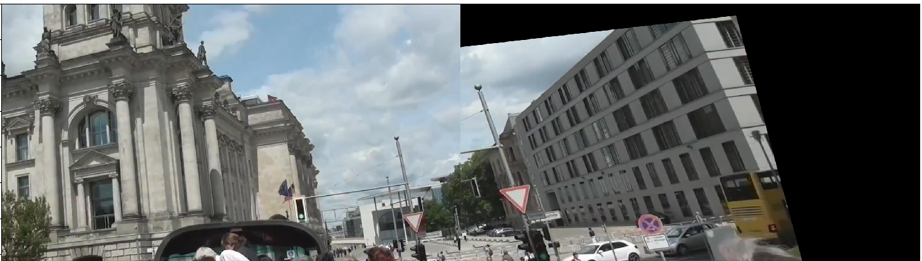
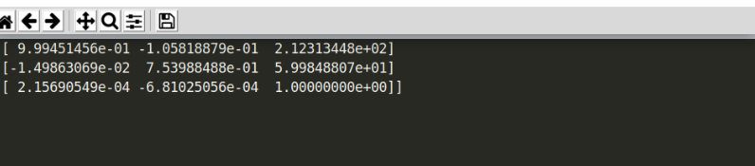

Slide 9
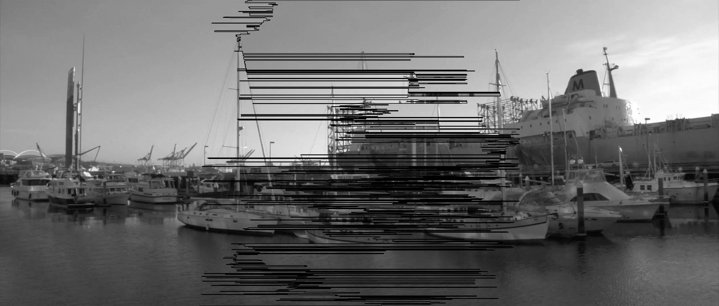
Results from Graph cut seam finding

Slide 10
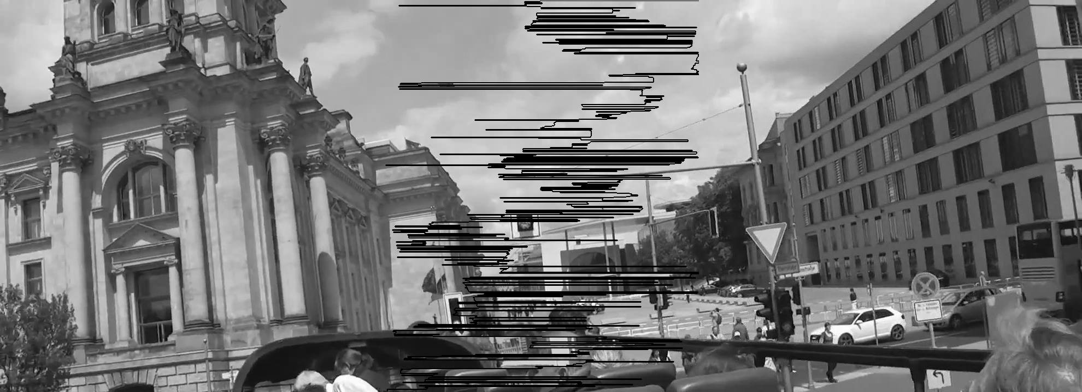

Slide 11
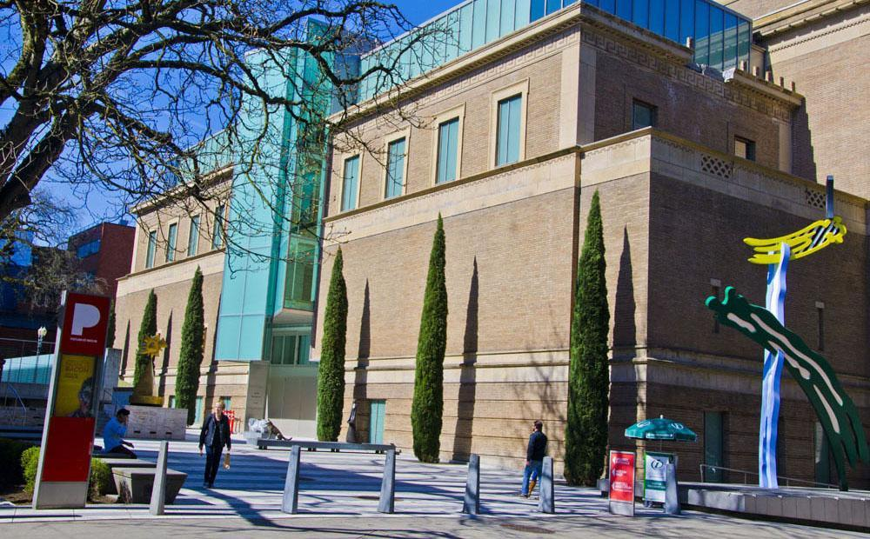
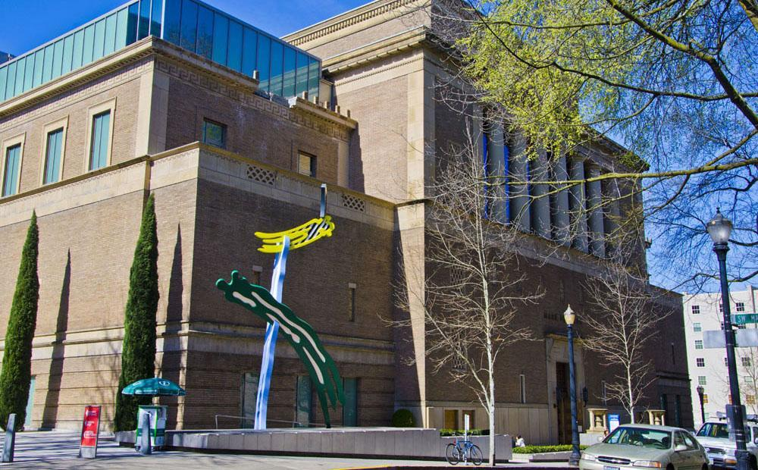
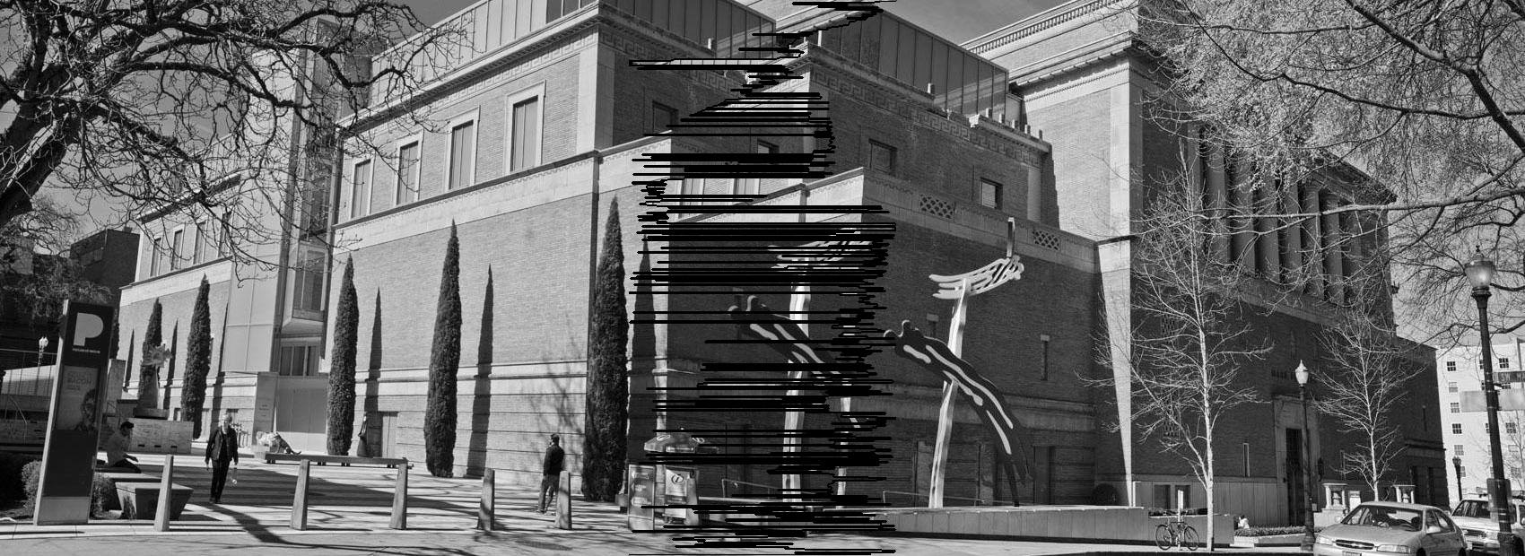

Slide 12
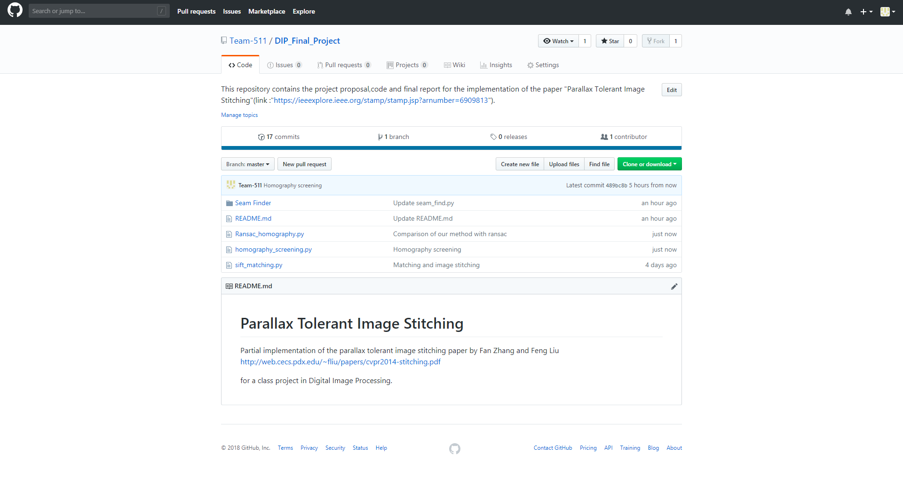
Code is present on github

Slide 13
Tasks completed
Matching sift features on input image as well as edge maps created using canny edge detector.
Graph cut seam finding method
Homography Screening
Image Stitching

Slide 14
Tasks to be completed
Randomizing graph cut seam find method
Image blending

Slide 15
Thank You!

